Slide 1

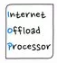


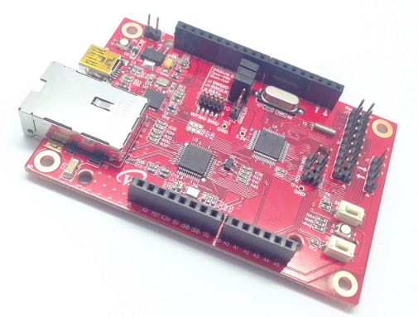

with
Start IoT Device development with WIZwiki-W7500 (Internet Piano & FTP & Cloud)

Slide 2
Index
The first step for IoT episode 1 - Server
To make Internet Piano (Web Server + PWM)
The first step for IoT episode 2 - Client
To make FTP camera (FTP Client + UART)
Develop Weather Forecast Device
The first step for IoT episode 3 – Cloud Server preview

Slide 3
The first step for IoT episode 1
What is the Server ?!

Slide 4
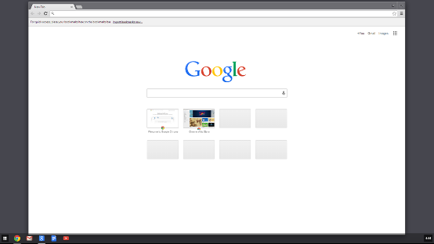


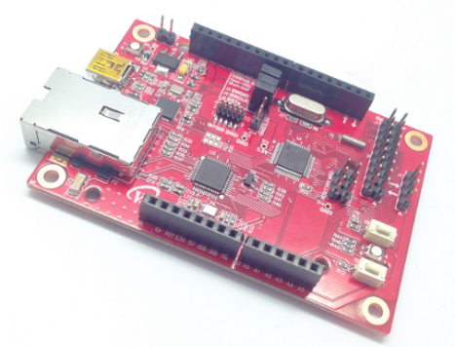
1. Embeded Web Server Overview
HTTP Request
Client
Server
Router
Web Browser
WIZwiki-W7500
HTTP Response

Slide 5
2. HTTP Overview
HTTP is composed of Client / Server
HTTP Server : WIZwiki-W7500
HTTP Client : Web Browser
Web Server transmit the required HTML Web page, etc. to Web Browser
Web Browser
(HTTP Client)
HTTP GET/POST Request e.g., ‘set_dio.cgi’
WIZwiki-W7500
(HTTP Server)
HTTP/1.1 300 OK Response(+Return values)

Slide 6
3. HTTP Method
GET
The way to get value of Web Server
Client gets DATA which is in Web Server storage
POST
The way to transmit changed value to Web Server
When Client changes the value, Device is asked to request and then changes the value

Slide 7
To make Internet Piano
Web Server + PWM

Slide 8
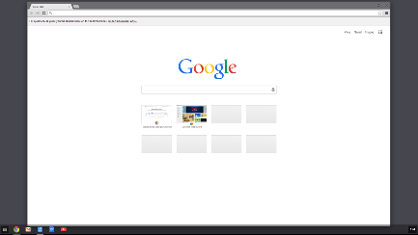


1. Internet Piano Overview
Client
Server
HTTP Request
HTTP Response
PWM OUT
HTTP Request

Slide 9
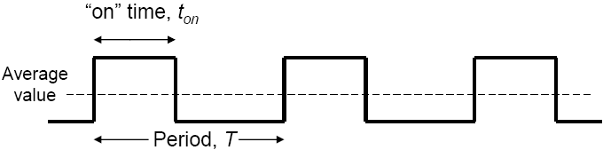
2. Theory of PWM
Pulse width modulation(PWM) uses digital waveform to control analogue value.
To make duty cycle, pulse width is controlled for fixed period.
duty cycle = 100% * (pulse width)/(pulse period)

Slide 10
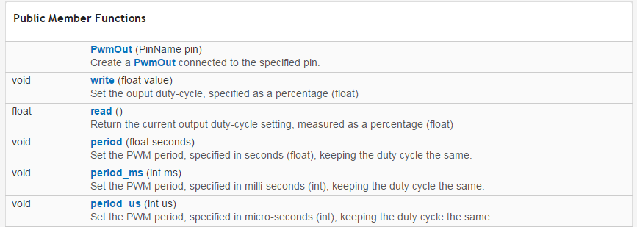
2. Theory of PWM - PWM mbed Library
PWM Functions in mbed Library - 1
https://developer.mbed.org/handbook/PwmOut
Link for example
https://developer.mbed.org/users/mbed_official/code/mbed/docs/tip/classmbed_1_1PwmOut.html
Link for function description
Declare PWM Output pin
Set duty-cycle of PWM Output
Enter a value between 0.0f and 1.0f
Read current value of PWM Output duty-cycle
Set period of PWM Output
Default value is microseconds

Slide 11
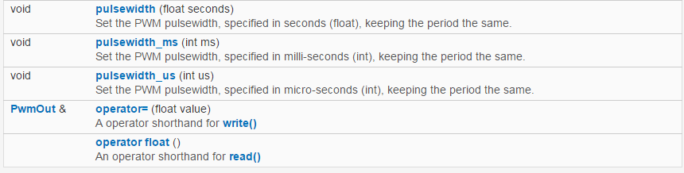
2. Theory of PWM - PWM mbed Library
2) PWM Functions in mbed Library - 2
Set pulsewidth of PWM
Set PWM pulsewidth in μS units

Slide 12
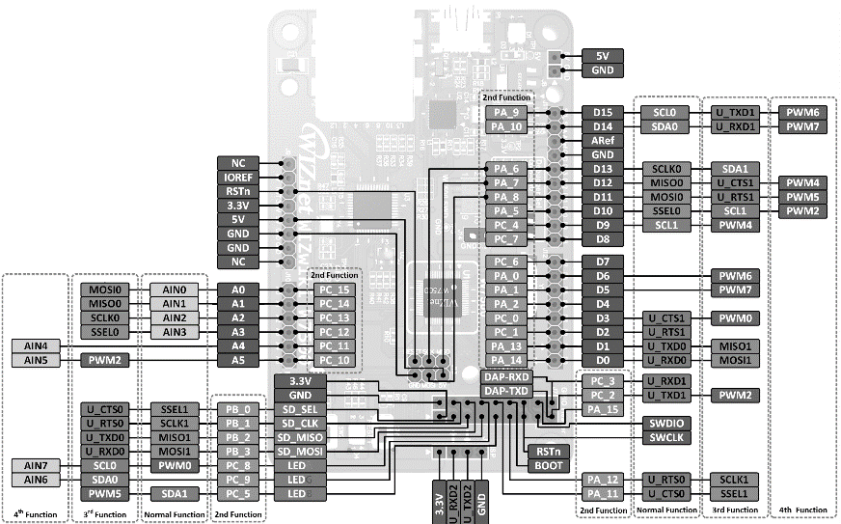
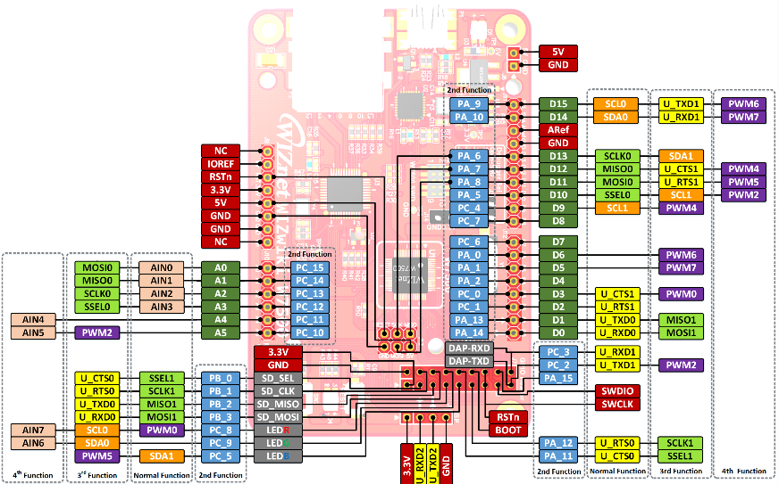
2. Theory of PWM - PWM Pinout

Slide 13
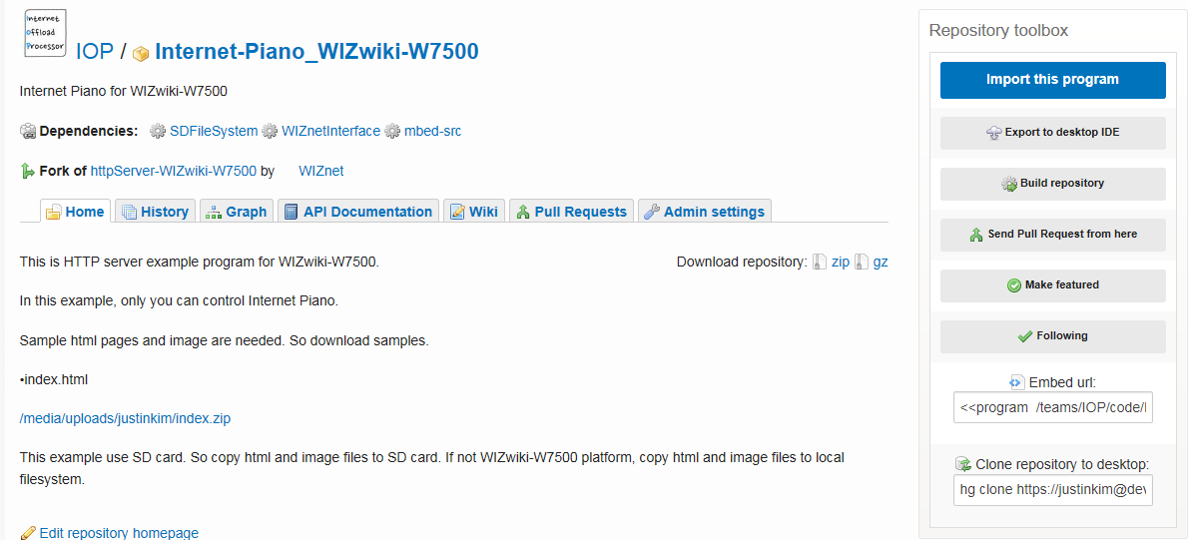
3. Internet Piano Practice - mbed Web Compiler
Import Internet Piano Example
https://developer.mbed.org/teams/IOP/code/Internet-Piano_WIZwiki-W7500/
Click ‘Import this program’!!
Download ‘HTML code’!!

Slide 14
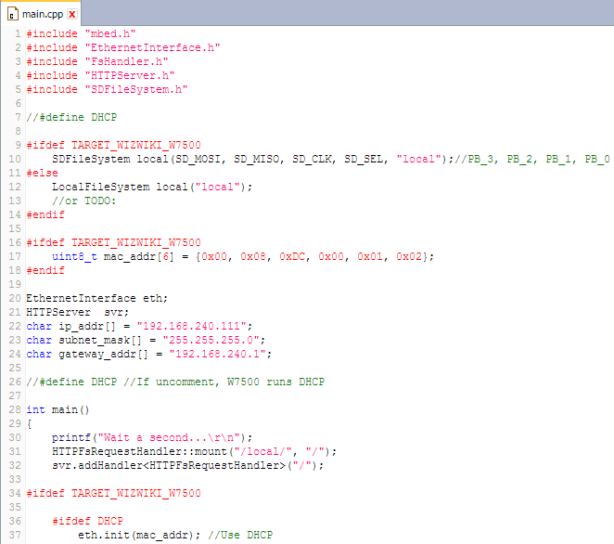
3. Internet Piano Practice - mbed Web Compiler
2) IP setting description
Link the library you need using #include
Set IP address, Subnet mask and Gateway
It can be changed to the value what you want

Slide 15

3. Internet Piano Practice - mbed Web Compiler
3) Web server operation process description - 1 (HTML page)
Call function setDiostate(o)
Call function move(o)

Slide 16
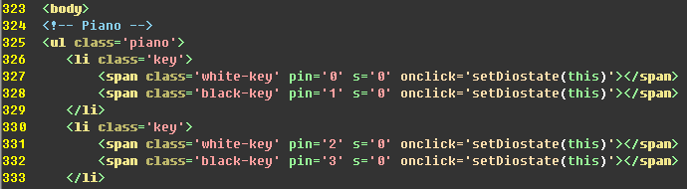
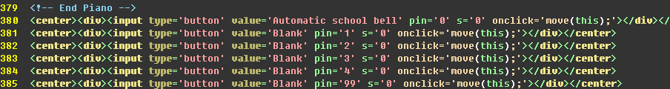
3. Internet Piano Practice - mbed Web Compiler
4) Web server operation process description - 2 (HTML code)
Set pin = 0 Call setDiostate()
Set pin = 0 Call move()

Slide 17
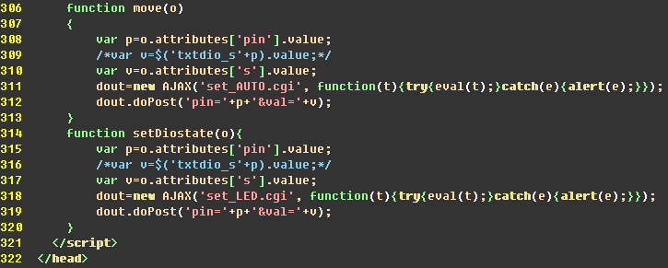
3. Internet Piano Practice - mbed Web Compiler
5) Web server operation process description - 3 (HTML code)
Send ‘set_AUTO.cgi’
Send ‘set_LED.cgi’

Slide 18
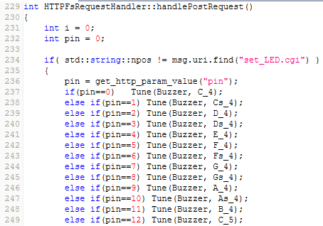
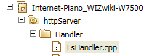
3. Internet Piano Practice - mbed Web Compiler
6) Web server operation process description - 4 (mbed code : httpServer/Handler/FsHandler.cpp)
If it’s ‘set_LED.cgi’, perform this code below
If Pin = 0, call Tune function

Slide 19
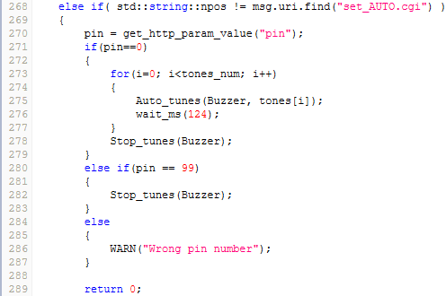
3. Internet Piano Practice - mbed Web Compiler
7) Web server operation process descriptio- 5 (mbed code : httpServer/Handler/FsHandler.cpp)
If it’s ‘set_AUTO.cgi’, perform this code below
If Pin = 0, call Auto_tune function

Slide 20
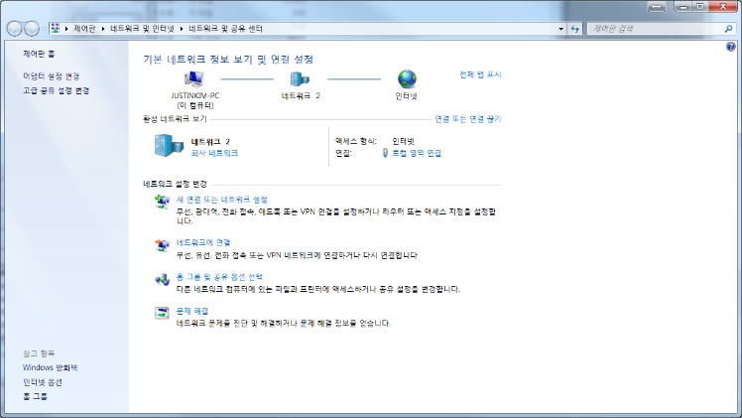
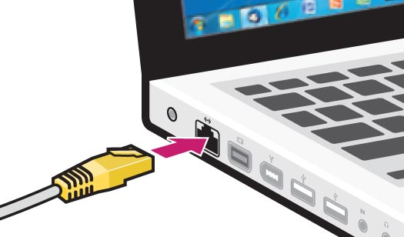
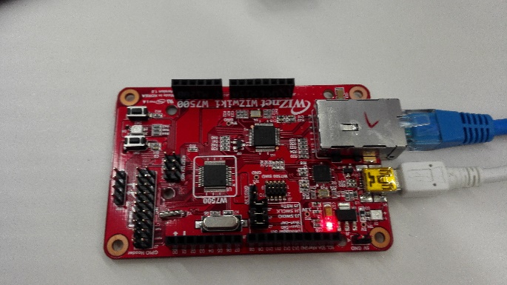
4. IP setting
1) IP setting & Ethernet cable connection (PC to WIZwiki-W7500)
Connect PC with
WIZwiki-W7500
using Ethernet cable
Go to ‘Network and Sharing Center’
and Click “Local Area Connection”

Slide 21
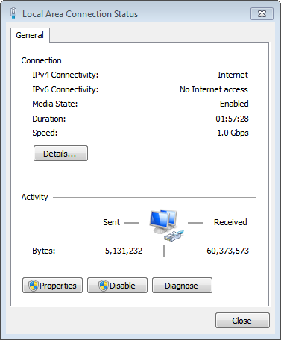
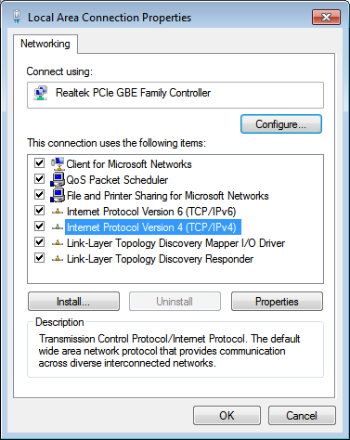
4. IP setting
2) IP setting & Ethernet cable connection (PC to WIZwiki-W7500)

Slide 22
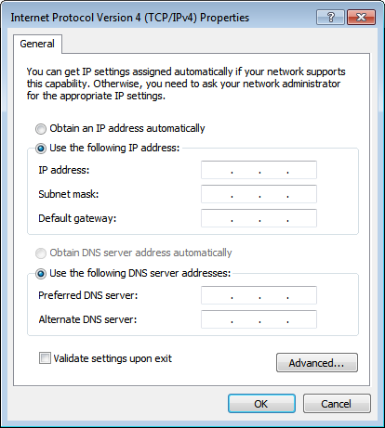
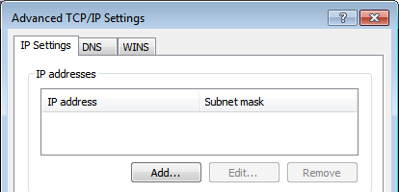
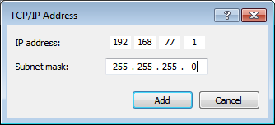
4. IP setting
3) IP setting & Ethernet cable connection (PC to WIZwiki-W7500)
Network address =
Network address on coding
Host address
= Own Table number
Subnet mask
= 255.255.255.0

Slide 23
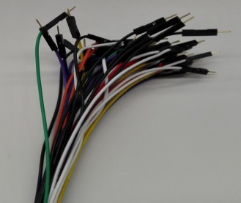

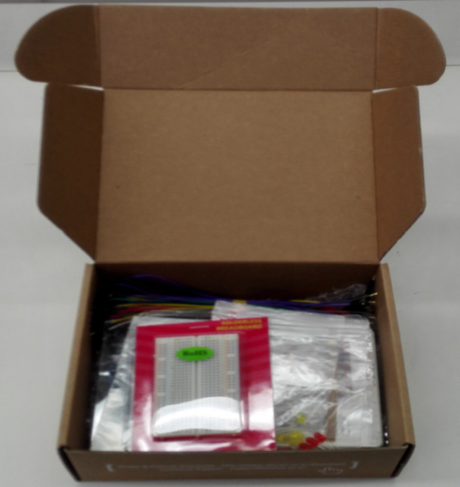
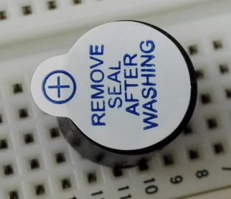
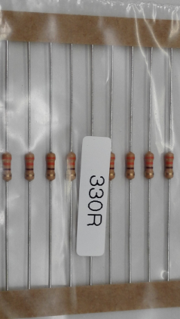
5. H/W implementation - W7500 Starter Kit
Use WIZwiki-W7500 Starter Kit
SM-1205C
330 ohmic resistance

Slide 24
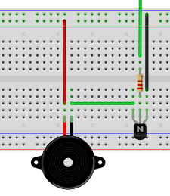
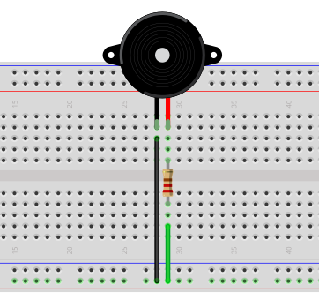
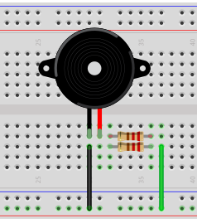
5. H/W implementation - W7500 Starter Kit
Ref.
E
2) Breadboard Layout
GND
B
PWM
C
GND:GND
5v
sound amplification using a transistor
Ref.
GND
GND
330옴
330옴
D3(PWM):VCC
PWM
sound amplification using parallel connection of resistance

Slide 25
Index
1. To make Internet Piano (Web Server + Buzzer)
2. To make Ethernet Camera (Web Server + Camera)
3. Web Client
Weather Forecast Device Development
4. Cloud Server
Cloud Server Preview

Slide 26
The first step for IoT episode 2
What is the Client ?!

Slide 27


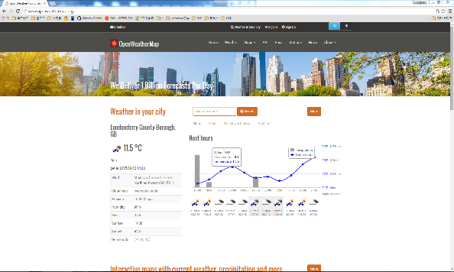
1. Web Client
HTTP Response
Server
DHCP Server
Client
Router
www.openweathermap.org
WIZwiki-W7500
HTTP Request

Slide 28
2. What is DHCP ?
Only if computer should have unique IP address to access internet. But if you use DHCP, internet can be accessed without unique IP address.
DHCP rents valid IP which can be used for a period of time to client that requests IP. Therefore, when there is more computers than the number of IP address which is available, DHCP can reconfigure network dynamically by making the rent time of IP address short.

Slide 29
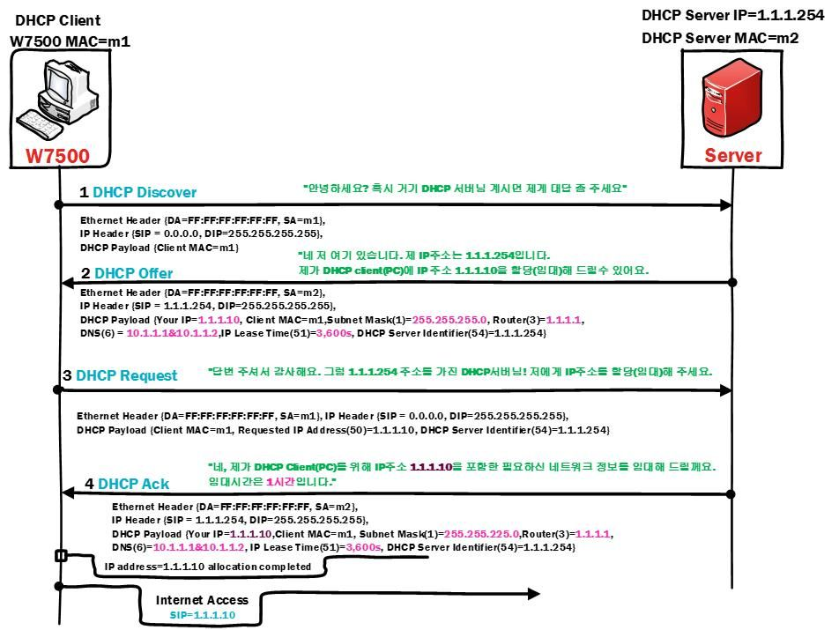
2. DHCP operation principle
1. Client -> Server : Find DHCP server
2. Server -> Client : Response DHCP server
3. Client -> Server : Request valid IP address
4. Server -> Client : Allocate valid IP address
5. Client -> Internet

Slide 30
To make FTP Camera
FTP Client + UART

Slide 31

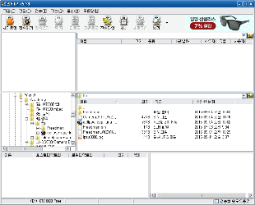
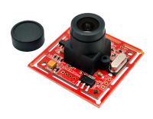
1. FTP Camera Overview
Data port
Command port
5150
5151
Server
Client
Port 5150
OK
UART
DATA
ACK

Slide 32
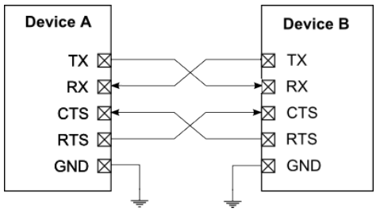
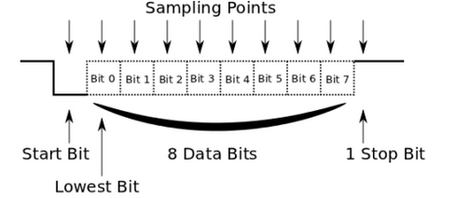
2. Theory of UART
1) Universal Asynchronous Receiver Transmitter (UART) transmit data along the serial system.
Sender and receiver should have same Baud Rate because it’s basically asynchronous communication.
(9600 bps can transmit and receive 9600 bits per 1 sec.)
3) UART data flow is controlled by RTS(Request to Send), CTS(Clear to Send).

Slide 33
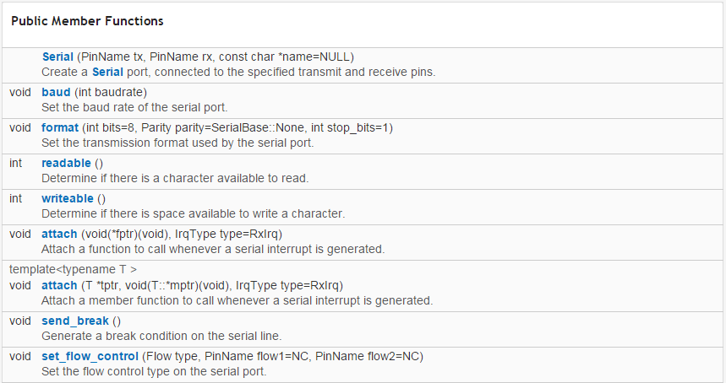
2. Theory of UART - Serial UART mbed Library
Serial UART Functions in mbed Library
https://developer.mbed.org/handbook/Serial
Link for example
https://developer.mbed.org/users/mbed_official/code/mbed/docs/tip/classmbed_1_1Serial.html
Link for function description
Declare pin in tx, rx parameter
Function which can set Serial baudrate
Function which checks the space that is available to read in buffer
If value of return is ‘1’, read is available, otherwise not available
Function which checks the space that is available to write in buffer
If value of return is ‘1’, reading is available, otherwise not available

Slide 34
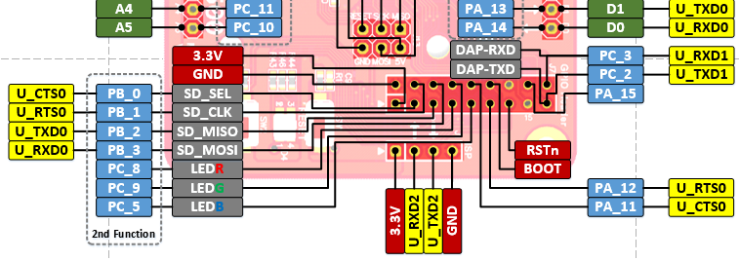
2. Theory of UART - Serial UART Pinout
UART Pinout. UART0, UART1
UART1 is possible to input/output with USB cable
USB
UART Pinout

Slide 35
2. Theory of UART - Serial UART Pinout

Slide 36
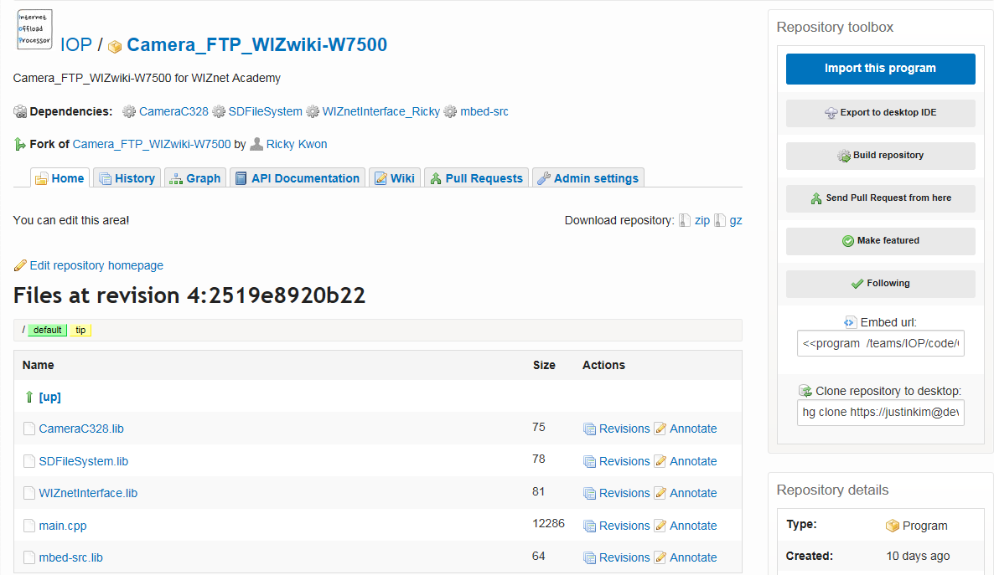
3. FTP Camera Practice - mbed Web Compiler
Import FTP Camera Example
https://developer.mbed.org/teams/IOP/code/Camera_FTP_WIZwiki-W7500/
Click ‘Import this program’ !!

Slide 37
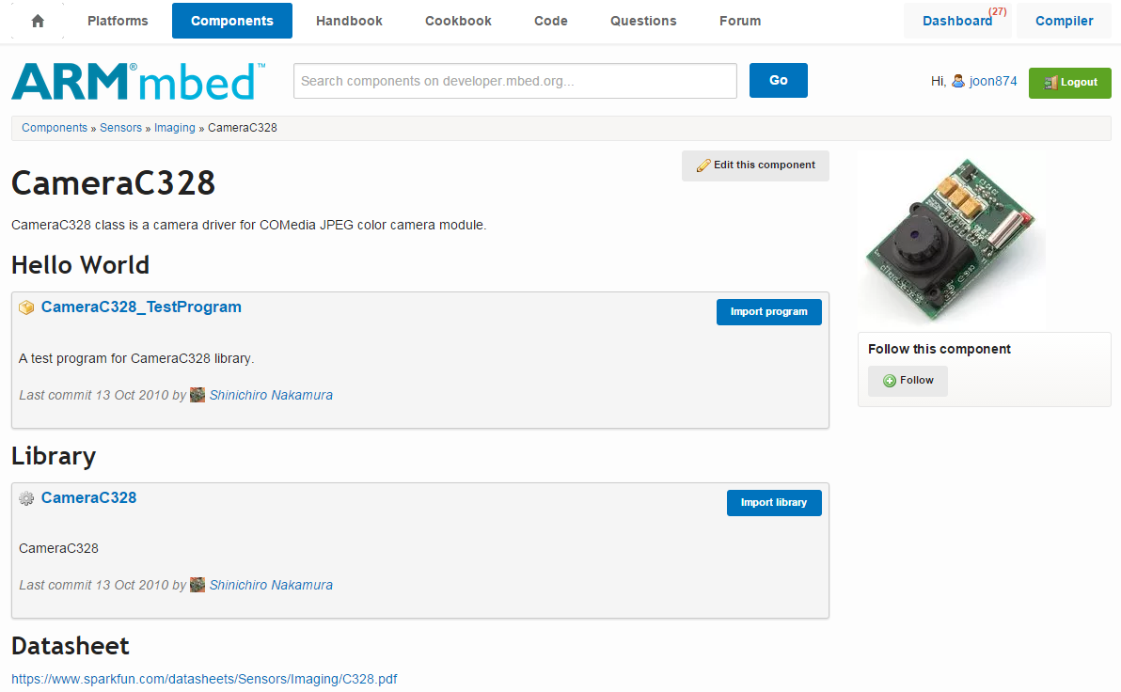
3. FTP Camera Practice - mbed Component
2) Camera Component for practice
https://developer.mbed.org/components/CameraC328/
You can refer to
example code
library
datasheet of camera which is registered as mbed component

Slide 38
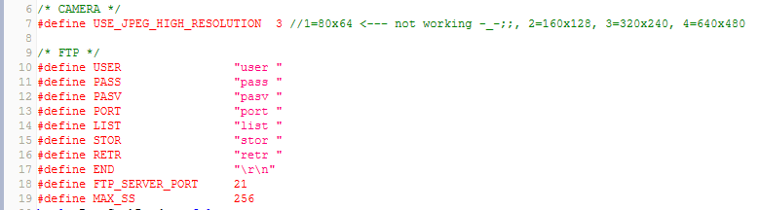
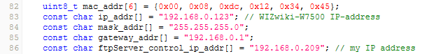
3. FTP Camera Practice - mbed Web Compiler
3) Description of IP Setting and pin mapping
Set size of Image default 3; (320x240)
Set FTP SERVER PORT to be accessed
Set FTP SERVER ID and PASSWORD to be accessed
MAC address, IP address, Subnet mask, Gateway setting; It can be changed to value of address what you want

Slide 39
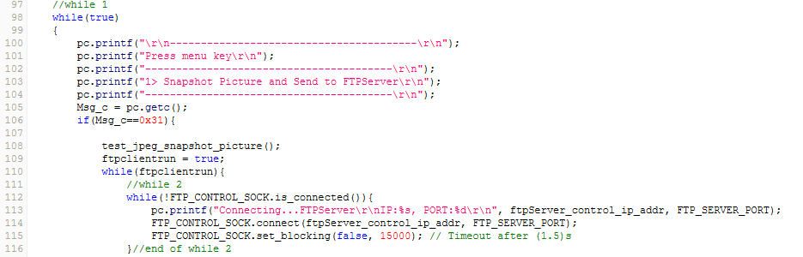
3. FTP Camera Practice - mbed Web Compiler
4) Source Description of FTP Client operation process - 1
If 1 is entered to Serial, execute the code below
Execute Snapshot picture function (Clicking picture)
Connect FTP server

Slide 40
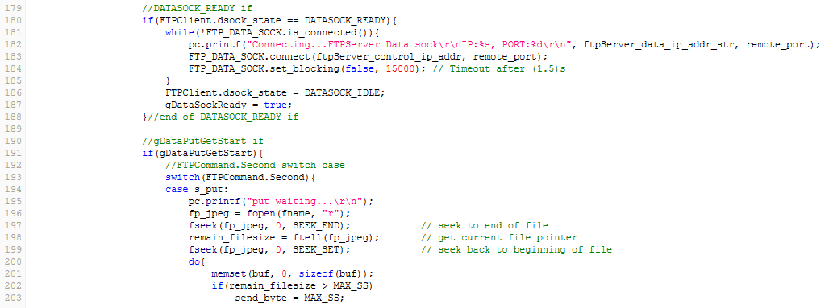
3. FTP Camera Practice - mbed Web Compiler
5) Source Description of FTP Client operation process - 2
Ready FTP DATA Socket
Transmit Data
.
.
.

Slide 41
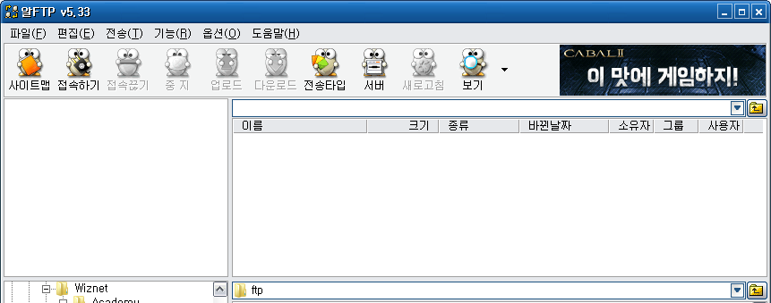
3. FTP Camera Practice - AL FTP
6) FTP server setting process - 1 (FTP Server)
http://sdn.altools.co.kr/setup/ALFTP533.exe
Download Link for AL FTP
Clicks ‘Server Execution’ after clicking ‘server’!

Slide 42
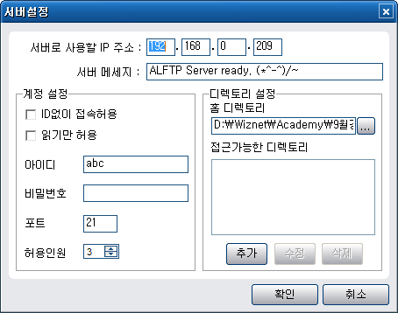
3. FTP Camera Practice - AL FTP
7) FTP server setting process - 2 (FTP Server)
Server IP setting (My IP Address)
Server account setting (ID, PASS, PORT)

Slide 43
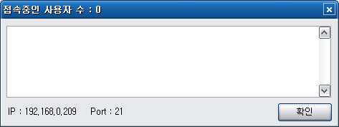
3. FTP Camera Practice - AL FTP
The number of Clients which is connecting currently
8) FTP server setting process - 3 (FTP Server)
The set value of Server account (IP, Port)

Slide 44

3. FTP Camera Practice - Serial Terminal
9) FTP Client operation description - 1 (Serial Terminal)
COM port num, Baud rate, 8, n, 1
When 1 is entered, picture shooting will be started

Slide 45

3. FTP Camera Practice - Serial Terminal
10) FTP Client operation description - 2 (Serial Terminal)
Picture shooting after Camera Init
Attempt FTP Server access
FTP Server is connecting …

Slide 46

3. FTP Camera Practice - Serial Terminal
11) FTP Client operation description - 3 (Serial Terminal)
FTP Server Connection Completion
File Transfer Completion
Ready to take a photo again

Slide 47

3. FTP Camera Practice - AL FTP
The number of Clients which is connecting currently
12) FTP server screen - 1 (FTP Server)
Information of Client Access

Slide 48

3. FTP Camera Practice - AL FTP
13) FTP server screen - 2 (FTP Server)
Image file which is transferred to FTP server

Slide 49
4. IP setting
1) IP setting & Ethernet cable connection (PC to WIZwiki-W7500)
Connect PC with
WIZwiki-W7500
using Ethernet cable
Go to ‘Network and Sharing Center’
and Click “Local Area Connection”

Slide 50
4. IP setting
2) IP setting & Ethernet cable connection (PC to WIZwiki-W7500)

Slide 51
4. IP setting
3) IP setting & Ethernet cable connection (PC to WIZwiki-W7500)
Network address =
Network address on coding
Host address
= Own Table number
Subnet mask
= 255.255.255.0

Slide 52

5. H/W implementation - W7500 Starter Kit
Use WIZwiki-W7500 Starter Kit
C328 Camera

Slide 53
5. H/W implementation - W7500 Starter Kit
2) Breadboard Layout
5V:VCC
5V
VCC
RX
TX
GND
GND
D1(Tx):Rx
D0(Rx):Tx
GND:GND

Slide 54
The first step for IoT episode - 3
Cloud Server Preview

Slide 55






1. Cloud Server
DHCP Server
Router
Cloud Server
DATA
WIZwiki-W7500

Slide 56

2. “dweet.io” Cloud Service
1) Use Cloud service of dweet.io- 1
Click
Connect dweet.io

Slide 57


2. “dweet.io” Cloud Service
2) Use Cloud service of dweet.io- 2
1
2
Enter name of Things
Click this to post DATA of Things in Cloud Server
Enter the arbitrary data in json format
{
“a0”:100 // 100 is arbitrary value
}
3
Click

Slide 58

2. “dweet.io” Cloud Service
3) Use Cloud service of dweet.io - 3
Format that transfer(POST) data of Things to save to Cloud Server
Data Format of Response(GET) of Cloud Server; json type
You can use Cloud Service by using name of Things which is entered now!

Slide 59

3. Cloud Service - mbed Web Compiler
Import Weather Forecast
https://developer.mbed.org/teams/IOP/code/dweetIo_CloudService_Helloworld_WIZwiki-/
Click ‘Import this program’!!

Slide 60

3. Cloud Service - mbed Web Compiler
2) Code Description- 1
Link the library you need using #include
Set this as ‘1’ to be assigned valid IP using DHCP.
Input MAC address
PIN which will read analog value of Things

Slide 61

3. Cloud Service - mbed Web Compiler
3) Code Description - 2
Enter name of Things which is entered into dweet.io
POST the name of Things and value of analog to Cloud Server with data type which is decided
Update data change to Cloud Server every 5 seconds

Slide 62

3. Cloud Service - mbed Web Compiler
4) Serial Terminal screen
Serial Terminal screen
The format which transfers(POST) to Server
Get data of Server json type

Slide 63


3. Cloud Service - mbed Web Compiler
5) Let’s check data on Cloud Server
1
Data in text format
Copy & Paste address which is outputted on Serial Terminal
2
Enter this in the address bar directly
http://dweet.io/follow/nameYouWant
Graph which is updated in a real time
Name of Things which is entered into dweet.io

Slide 64
QnA Thank you.

